Slide 2
Objectives
Know what social media is and the risks of using it including:
Strangers
Cyberbullying
Inappropriate content
Be able to report concerns
Understand the importance of protecting your online identity including the use of privacy settings

Slide 3

Starter
Social media are apps and websites that allow you to view and share media content and discuss it
What are the names of each of the social media apps shown on the right?

Slide 4
Starter
Social media are apps and websites that allow you to view and share media content and discuss it
What are the names of each of the social media apps shown on the right?
YouTube
Facebook
TikTok
Instagram
X
Snapchat
LinkedIn
Pinterest
Reddit

Slide 5
Online risks and dangers
One risk online is from cyberbullying
What do you think two other risks are online?
Risks
Cyberbullying
?
?

Slide 6
Online risks and dangers
One risk online is from cyberbullying
What do you think two other risks are online?
Risks
Online strangers
Inappropriate content
Cyberbullying

Slide 7


Cyberbullying
Cyberbullying is where people are bullied using technologies such as mobile phones or the Internet
It includes threats, spreading rumours and posting embarrassing images or videos
How could you deal with a cyberbullying problem?

Slide 8

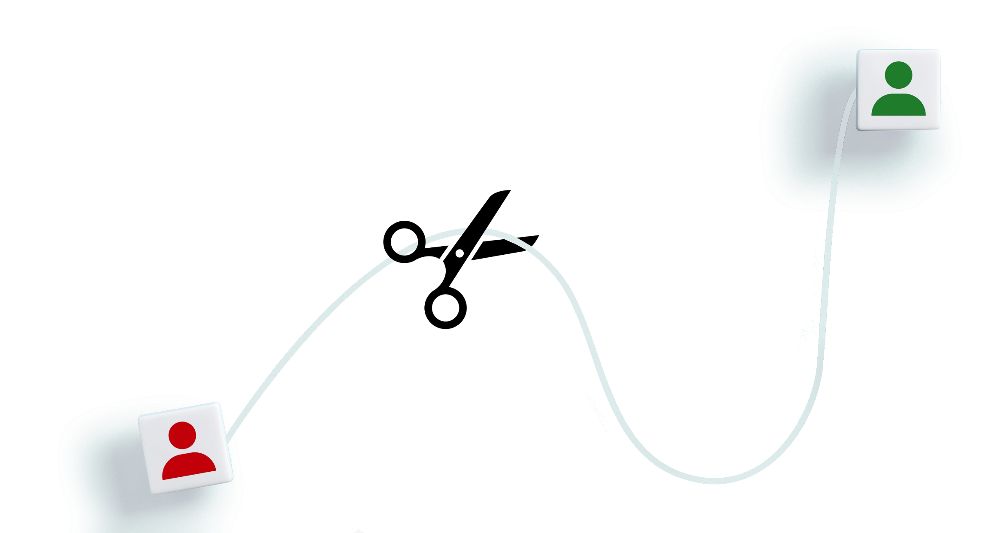
Cyberbullying
How could you deal with a cyberbullying problem?
Don’t reply, however tempting
Block the sender
Save any evidence
Tell someone you trust such as a parent or teacher
Use a ‘Report’ button (more about this later)

Slide 9

Online strangers
People online may not be who they say they are
Many children each year come to harm this way
To keep safe:
Only add people to your social network who you know offline
Never use social networks that connect you with random people

Slide 10

Inappropriate content
Other people may have posted inappropriate content that you might encounter including:
Abusive messages
Sexually explicit material (nudity, pornography)
Dangerous activities
Upsetting content
If you are worried or upset by the content, talk with a trusted adult such as a parent, teacher or Childline
What else could you do?

Slide 11

Reporting concerns
What else could you do?
Report school related problems to your school to help them to resolve the issue
Report inappropriate content to the social media owner to help get the content removed
Make a report at CEOP (Child Exploitation and Online Protection / National Crime Agency)

Slide 12
Worksheet 2
Complete Task 1 and Task 2 of the Worksheet 2

Slide 13
Online profiles
Every image, video and message you post online will develop your online profile
It is so easy to copy, that you should assume it cannot ever be deleted
What you might be proud of now, might be embarrassing in the future
Future employers will likely access your profile
Look at the different information on the right
Discuss with a partner what the issues may be with posting each type of information
Personal information that could be posted online
Name
Address
Email address
Telephone number
Age
Date of Birth
Upcoming party
Holiday photos
Photographs of your friends and family

Slide 14
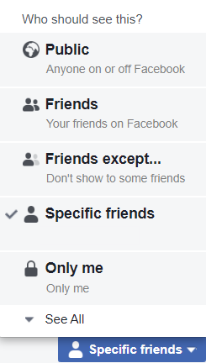
Privacy settings
Privacy settings are available on most social media websites
They enable you to control who can access your profile, and what information they can see
Remember, even if you select just specific friends to see your posts, these can still be copied and easily shared with many other people
If you aren’t aware of your privacy settings, assume that everyone in the world is able to see everything you post

Slide 15
Worksheet 2
Complete Task 3 of the Worksheet 2

Slide 16

Plenary
Answer these quick questions with a partner
Give three risks from using social media and the Internet
Give two people or places where you could report issues
Give one way you could improve your privacy settings on social media

Slide 17
Plenary
Give three risks from using social media and the Internet
Cyberbullying, Inappropriate content, Strangers
Give two people or places where you could report issues
Parents, school, CEOP
Give one way you could improve your privacy settings on social media
There are many ways, for instance, sharing posts only with selected friends, or turning off comments on videos you post

